Slide 1
SUNY New Paltz Career Resource Center Fieldwork Form
Team A1
Danny Dalton (s19-08) and Seraphim Dmitrieff (s19-09)
“Projects” class, Prof. Hanh Pham, Spring 2019

Slide 2
Outline
Problem Description
Business Context and Goals
Technical Requirements
Our Responsibilities
Technologies
Related Technologies
Newly Learned Skills/Technologies
Plan
Ideas For Solution
Programming/Coding Components
Schedule

Slide 3
Problem Description
The Career Resource Center works in tandem with the Records and Registration office to handle how field work translates to college credit for students. Currently, this is done by a written form and there’s a lot of room for error when filling it out (such as, screwing up writing down their supervisor’s e-mail).
The Career Resource Center has tried to get an outside web-based system for this, but they found it to be a very costly one, and what they got didn’t fit their needs as far as how the workflow is managed. They eventually decommissioned it in favor of having their written forms come back.

Slide 4
Our Task
Our task is to make an online system that handles this workflow the way that the Career Resource Center wants it.
Being a web-based system, this would require storing information about the Student, their Professor, their Department Chair and Secretary, and allowing the CRC and the Records and Registration office to have a view in as well.
We also want the system to be able to generate reminder e-mails to everybody when it’s their time to get on and fill out a specific part of the form, and to keep students updated on where their “form” is.

Slide 5
Technologies
For our task, we’re using many web-based technologies.
On our front end, we use HTML5 with PHP importing skeleton files, CSS 3 (with Bootstrap), and JavaScript (with jQuery loaded).
On our back end, we use PHP for scripting and SQL to manage our database.
We could use a Node.js/Vue.js stack, but PHP is easier to use on the Computer Science Server, due to how it’s set up.

Slide 6
Newly Learned Technologies
Danny: I’m learning back-end PHP and SQL as I’m working on this. Both languages are very new to me and it’s something I’ve wanted to learn for a while now.
Seraphim: Working with PHP to display both front-end user code as well as integrate a mySQL database into its functionality. Using SQL queries to manage a large amount of data as well as dynamically update information available on the front end.

Slide 7
Our Plan
We plan on using previous project work already developed as a starting point for our implementation.
Using the existing code, we are developing each segment of the application process separately, to allow for SQL submit queries to update our database.
Once each separate element is developed, we will work on linking each segment of the application process using JavaScript and boolean checks to determine who will be assigned to the next process in the Fieldwork Application.
Once we are able to link the process together, we will work on displaying multiple application elements based upon the user; as all of them may have more than one application assigned to them at one time.

Slide 8
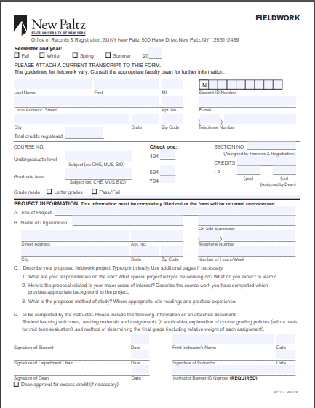

Slide 9
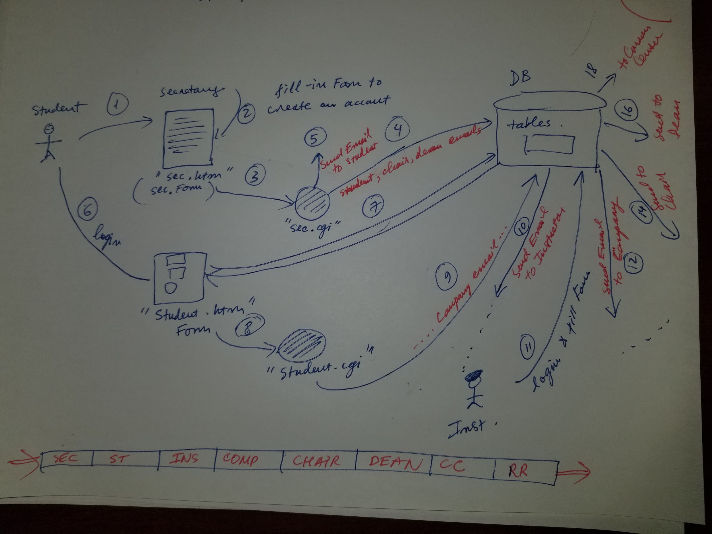

Slide 10
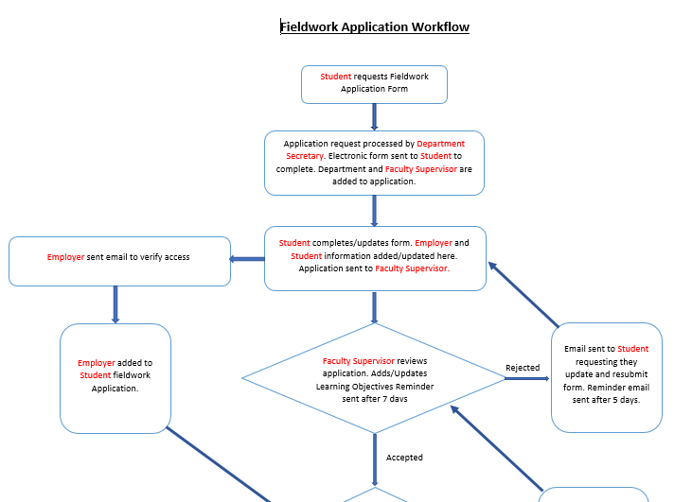

Slide 11
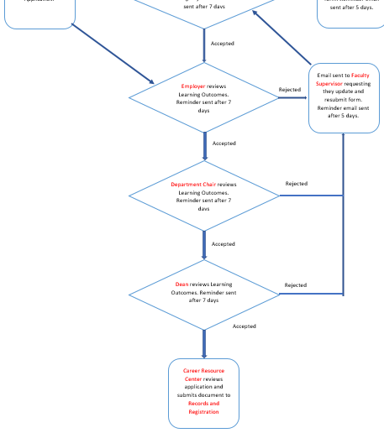

Slide 12
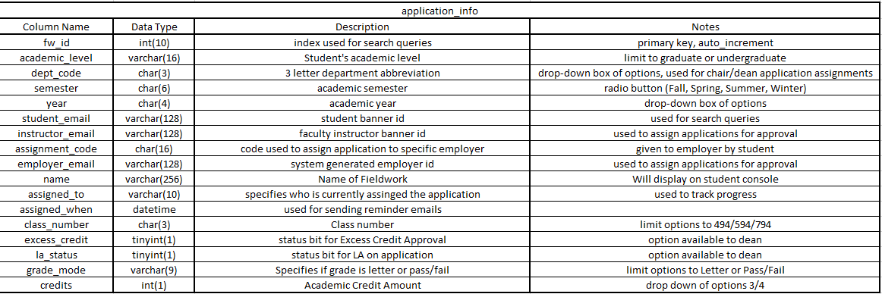
Fieldwork Form Design

Slide 13
Programming/Coding Components
We are using PHP for both our front-end and back-end coding as it allows us to seamlessly integrate HTML, Javascript and connecting to our MySQL database in addition to being able to call queries to our database.
We will be implementing sessions in our code to allow for our user data to be queried while using the same front-end code to allow us to display the relevant form data based upon the type of user accessing the system.
We will be implementing a progress bar system that will allow the student to see how far their field work application has gone (and see whose office is next up on taking care of that form).

Slide 14
Our Schedule
From January 23 to February 23: Design phase. Get an exact idea of what our client wants, design database structure, and get an idea of what students from previous semesters did.
From February 24 to March 5: Overhaul the design of the website. Fix file structure. Allow for prettier form submission output. Include a file for some utility functions (such as password generation, a variable pointing to the root of our project, etc.)
March 6: Present a proposal of our project to a class of very tired college students. Wish those students best of luck during midterm season.

Slide 15
Our Schedule, Continued
March 7-17: Work on log in/out functionality.
March 18-24: Work on Secretary Form logic and Records/Registration Office’s page.
March 25-31: Work on Student Form logic.
April 1-7: Work on Professor’s part of the form logic. Delete the codebase. (Haha, April Fool’s)

Slide 16
Our Schedule, Part 3
April 8-14: Work on Supervisor’s Form.
April 15-21: Work on Department Chair’s Form and the Career Resource Center’s Form. Wish everyone a Happy Thanksgiving (it says “Thanksgiving” on the course website).
April 22-28: Work on Dean’s Form and our final presentation poster.
Note: This is very tentative and subject to change.

Slide 17
Extra Goals, If We Have Time
Meet with a graphic designer to talk about the overall look and feel of the application.
Develop an admin console to more easily manage users information and search within the database based on filters.

Slide 18
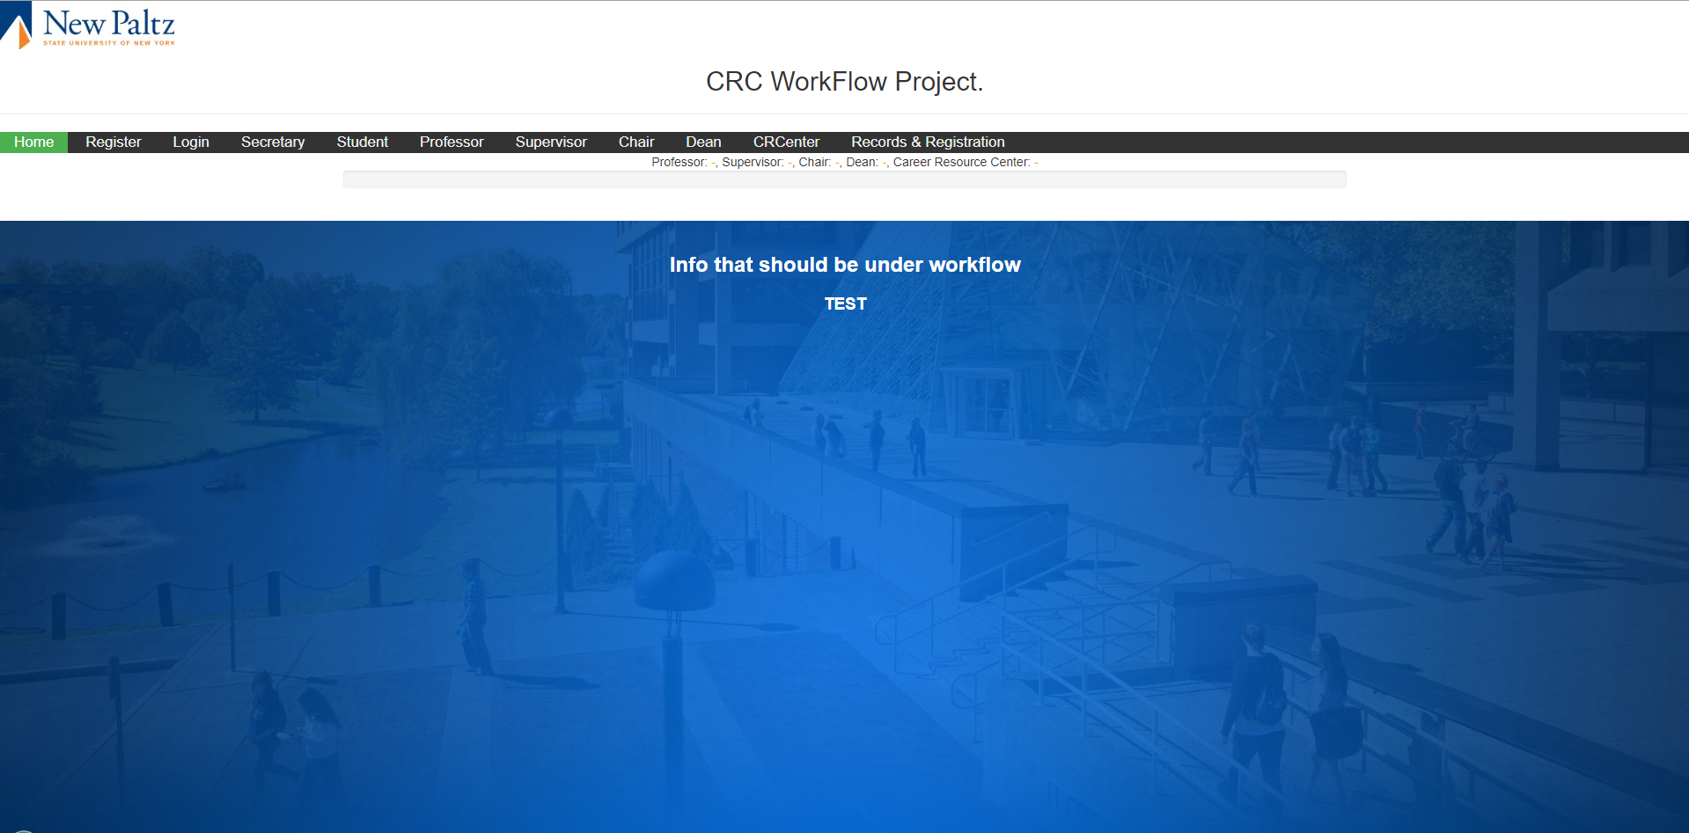
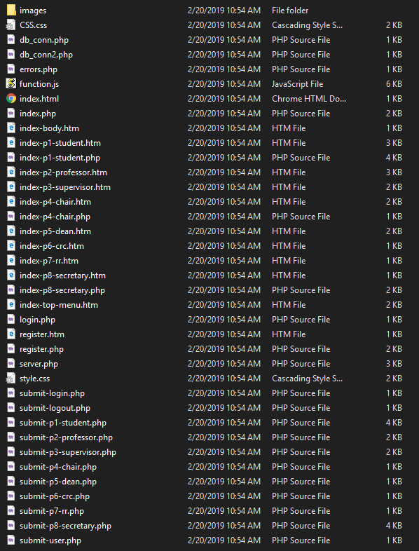
A Look Back on Fall 2018
In Fall 2018, this was the end result of the Fieldwork Form. The full thing can be seen at http://cs.newpaltz.edu/p/f18-02/s19-v1/v1/ . CSS was very inconsistent. Oh, and to top it off, the screenshot on the lower right was the file structure.

Slide 19
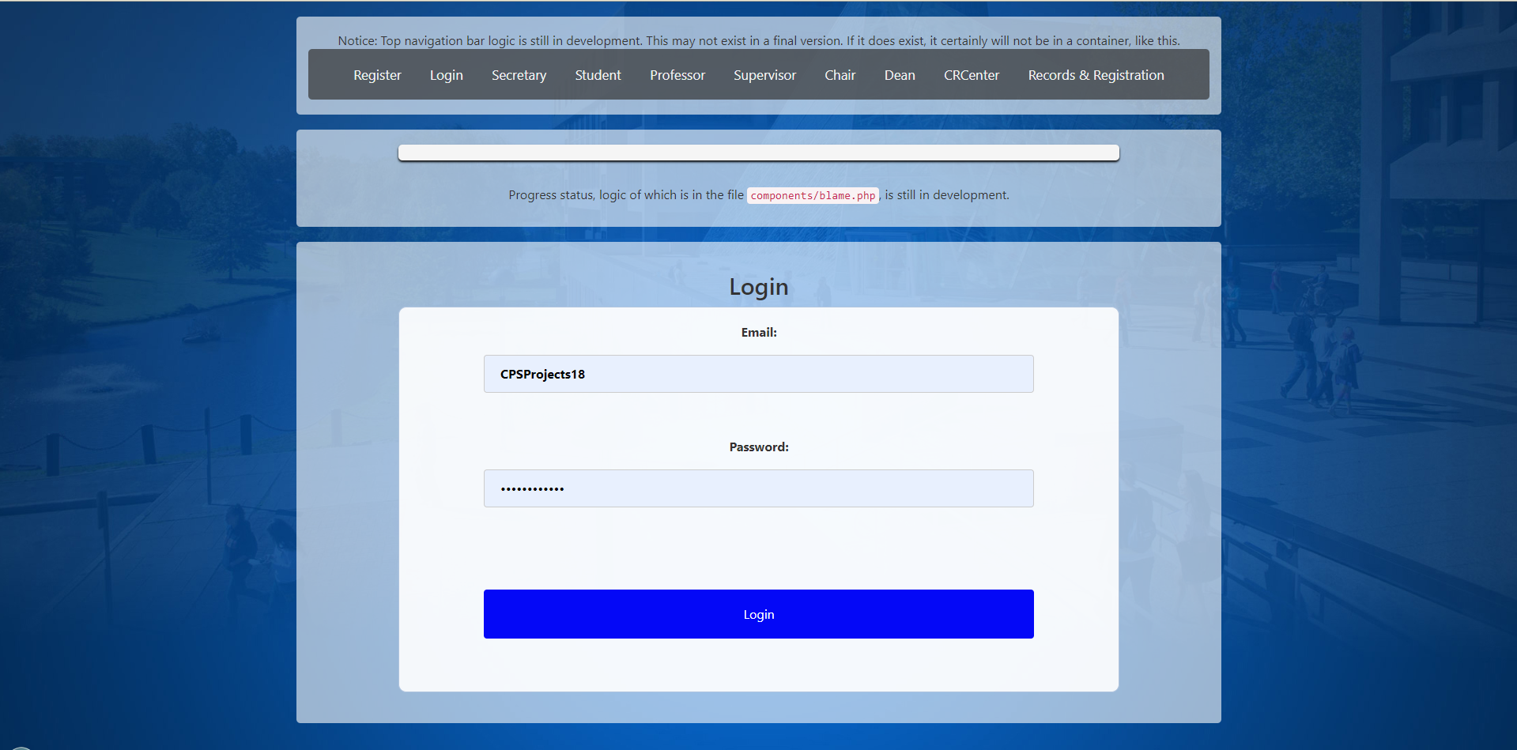
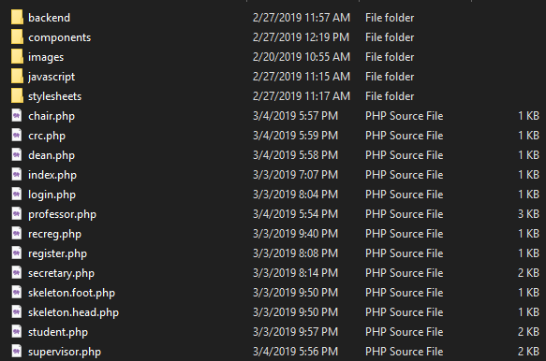
Compared to Now

